Slide 1
WOODLAND SCHOOL DISTRICT 2022-2023 YEAR END FINANCIAL SUMMARY
Presented by:
Stacy Brown
Exec Director of Business Services

Slide 2
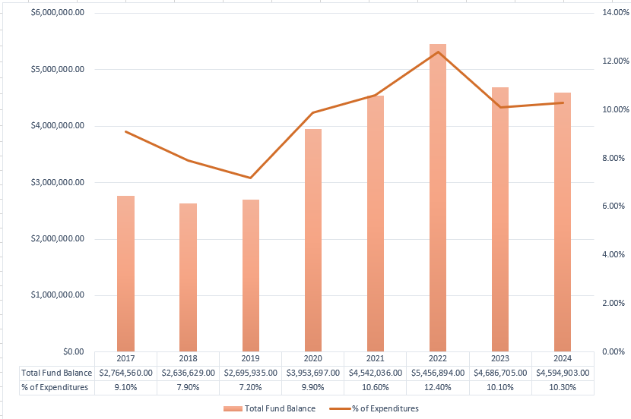
History of Total Fund Balance at Year-End and the Percentage of Budgeted Expenditures

Slide 3
Fund Balance/Enrollment
 | August 31, 2024 | August 31, 2023
Total Ending Fund Bal – (SF0/SF1) | $4,594,903 $2,148,684/$2,446,218 | $4,686,705 $2,421,277/$2,419,429
Restricted for Pgm Carryover | $ 0 | $ 0
Nonspendable for Prepaid Exp | $ 80,817 | $ 76,195
Assigned for Building/Dept CO – 2022 inc ELA Curriculum | $ 316,858 | $ 285,242
Unassigned Fund Bal | $4,197,228 | $4,325,268
Unreserved FB Decrease 21-22 to 22-23 | ($ 128,040) | ($ 269,957)
Budgeted Inc/(Dec) in FB | ($ 709,119) | ($ 616,250)
Actual Inc/(Dec) in FB | ($ 91,802) | ($ 770,189)
Budgeted Enrollment | 2,308.00 | 2,312.00
Actual Enrollment | 2,275.36 | 2,343.06

Slide 4
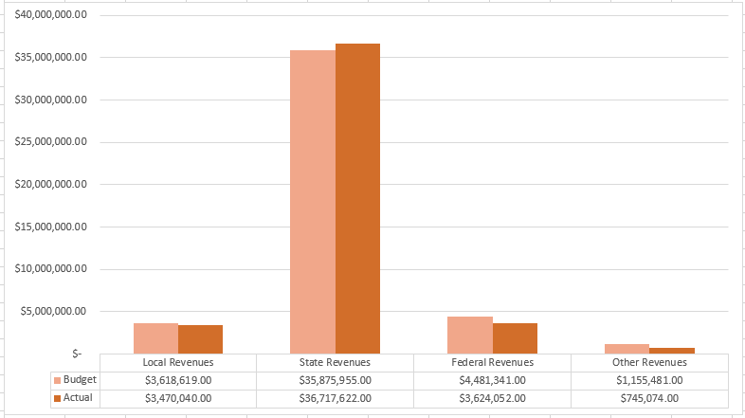
GF Revenues – Budget Compared to Actual

Slide 5
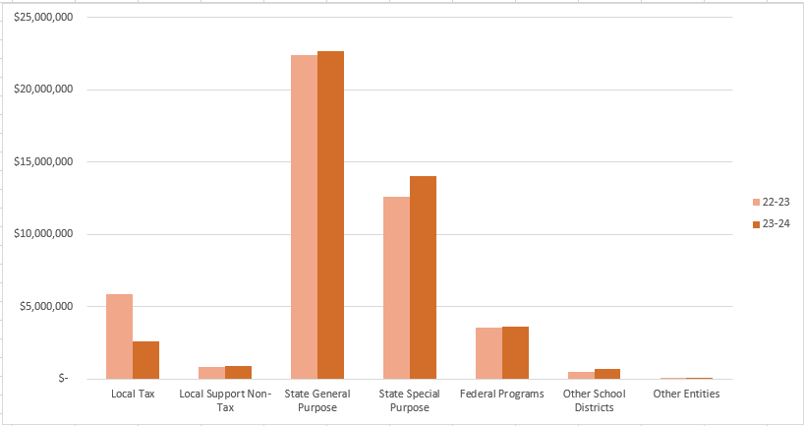
Revenues Compared to Prior Year

Slide 6
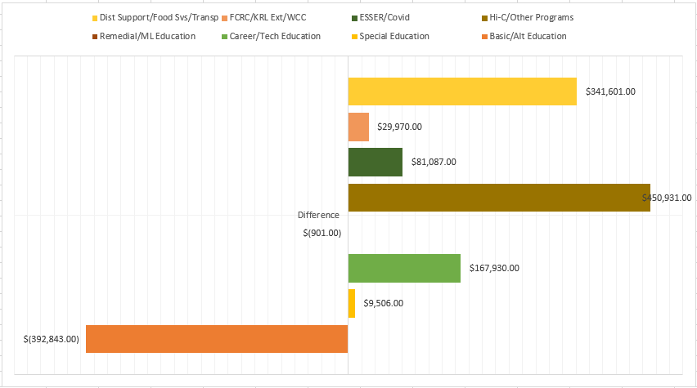
GF Program Expenditures – Variance to Budget

Slide 7
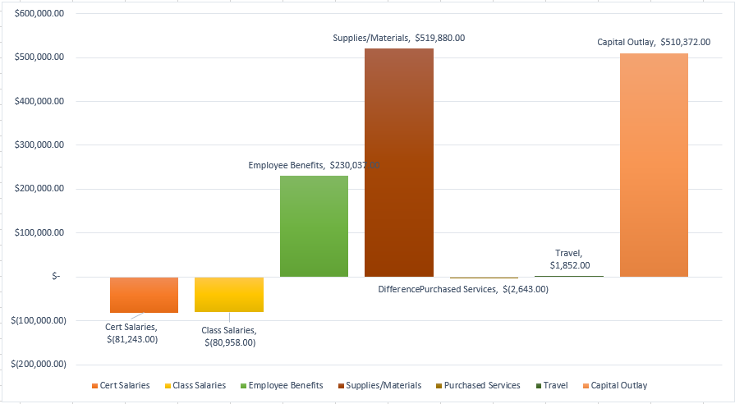
GF Object Expenditures – Variance to Budget

Slide 8
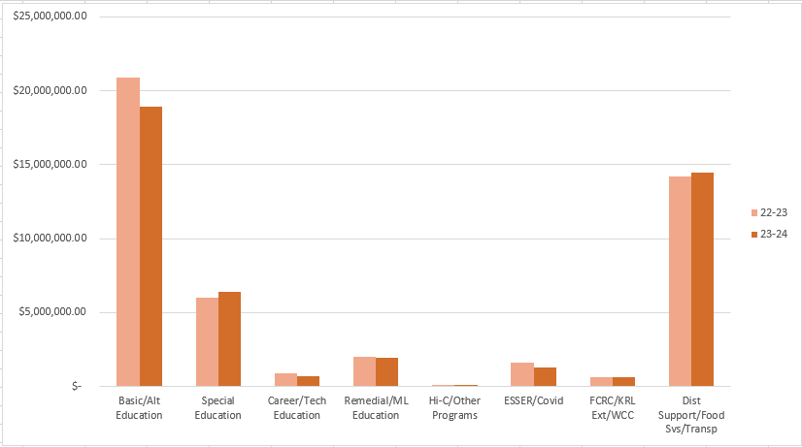
Program Expenditures Compared to Prior Year

Slide 9
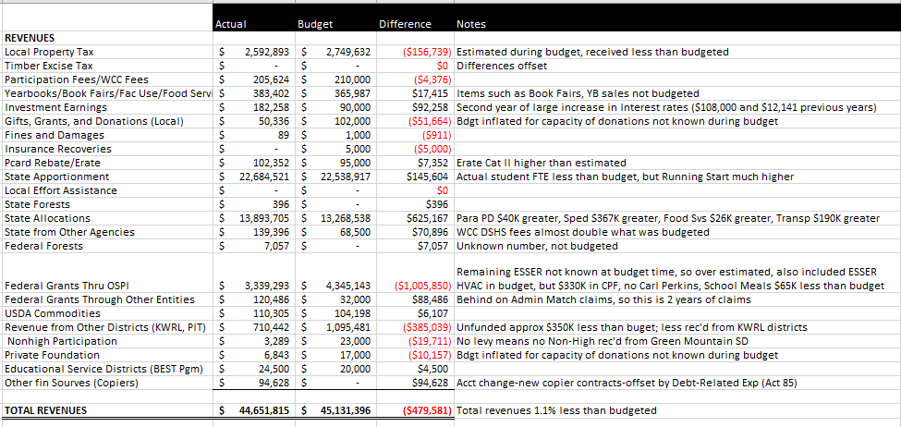
Detail Revenues Compared to Budget

Slide 10
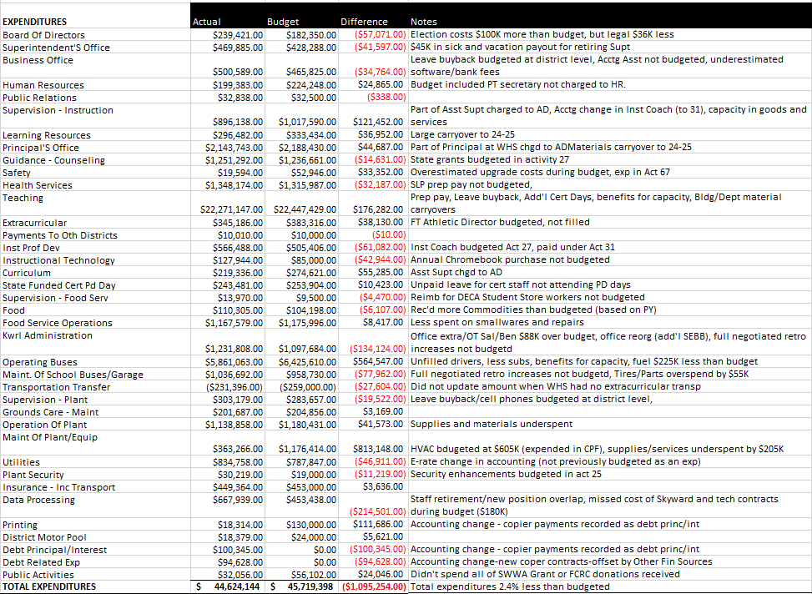
Detailed Expenditures (by Activity) Compared to Budget

Slide 11
Levy/Local Funds
Expenditure Type | Levy Dollars 2023-2024 | Levy Dollars 2022-2023
Certificated Salaries | $ 640,000 | $ 832,000
Classified Salaries | $ 1,273,000 | $ 2,186,000
Administrator Salaries | $ 275,000 | $ 481,500
Substitutes | $ 338,000 | $ 338,000
Benefits | $ 675,000 | $ 1,328,000
Supplies/Services/Travel/Utilities/Insurance | $ 467,000 | $ 467,000
Extracurricular | $ 344,517 | $ 661,500
Special Education | $ 290,000 | $ 777,400
Food Service Program | $ 43,662 | $ 156,000
To/From Transportation/Bus Purchase | $ 262,790 | $ 168,000
Daycare | $ 22,049 | $ 86,000
Family Resource Center | $ 8,115 | $ 12,300

Slide 12
Transportation & Food Service
Transportation
Food Service
Total Students transported = Approx 7,505 average per day and 375 Special Ed/Homeless per day average
Total Transp Exp/Util $8,122,000
Total Revenues $7,595,000
Total Unfunded/Util for year was $527,000 Budgeted unfunded plus utilities was $1,475,000. State Allocation was $190,000 more than budgeted and total expenditures were $344,000 less than budgeted.
Woodland’s portion of unfunded and utilities was $162,377 which represents 30.82% ownership of the Co-Op compared to 33.06% from 22-23.
Bus contribution for year $119,060
Total Meals Served = 42,307 Breakfasts (average of 235 per day) and 192,297 Lunches (average of 1,068 per day).
Summer Meals = program run from 6/24 through 8/16, serving a total of 867 breakfasts and 1,947 lunches.
Total Expenses = $1,291,853
Total Revenues = $1,248,192
Sodexo Guarantee ($69,353) - the actual for this year was ($83,184). There are about $7,000 of supply costs that are outside the contract, which would result in a loss of approximately ($76,418). We will be receiving a check from them for $7,065 for the guarantee.

Slide 13
Before and After School Care (WCC)
The WCC programs (at both CES and NFES) add opportunities for parents and students in a small community without many daycare options for families
Programs served about 140 families throughout the year and also provided summer care.
WCC program is licensed by the state and able to provide options for low income families. We received $127,000 in fees from DSHS last year to support these families.
Daycare programs ran at a loss of $22,000. Last year they had a loss of $87,000. This is due to the increased DSHS families and approximately $18,000 in grants and donations received.
The program continues to provide an important service in a community with very little daycare available and providing convenience for parents.

Slide 14
Other Funds
Capital Projects
Debt Service
ASB
Transportation vehicle

Slide 15
Capital Projects Fund
Beginning Fund Balance $ 710,682
Revenues/Other Fin Srce $ 574,539
Expend/Other Fin Uses $ 549,034
Ending Fund Balance $ 736,187
Expenditures were approx. $374,000 for ESSER funded HVAC projects and a about $8,000 for the KWRL projects. Total Fund Balance is made up of $255,354 in Impact Fees, $95,284 Designated for Future Capital Projects and $345,048 for KWRL projects.

Slide 16
Debt Service Fund
This fund is used to collect tax revenue and pay the principal and interest on bonds. Payments are made twice a year, December and June.
 | Debt Balance 8/31/23 | Debt Issued/ Increased | Debt Redeemed/ Decreased | Debt Balance 8/31/23
Voted Debt | $41,695,000 | $ 21,225,000 | $ 22,985,000 | $39,935,000
Pension Liability** | $ 3,645,375 | $ 358,943 | $ 865,336 | $ 3,138,982
Compensated Absences** | $ 631,466 | $ 50,073 | $ 0 | $ 681,539
Leases Payable** | $ 303,071 | $ 94,627 | $ 93,273 | $ 304,425
Total | $46,274,912 | $ 415,694 | $ 3,080,491 | $46,274,912
** Required to be reported, per accounting rules. Not debt owed.
Amount available for principal/interest at August 31, 2024 = $1,768,989

Slide 17
ASB FUND
ASB funds are for the extracurricular benefit for the students. Their involvement in the decision-making process is an integral part of associated student body government.
Beginning Fund Balance $315,590
Revenues $325,722
Expenditures $268,370
Ending Fund Balance $372,942

Slide 18
TRANSPORTATION VEHICLE FUND
This fund is used to replace buses. Revenue comes from the State (in the form of depreciation payments), interest earned on the investments and the annual levy payments made by the four Co-Op districts.
Beginning Fund Balance $3,983,747
Revenues $2,055,753
Expenditures $ 749,861
Ending Fund Balance $5,289,639

